Slide 1
IOT

Slide 2
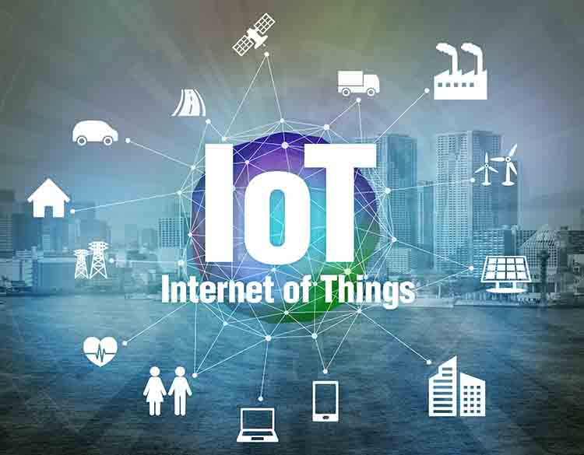
What is IOT
Simply the long form is Internet of things.
This is system of interrelated computer devices ,which can be used to collect and exchange data.

Slide 3
Vulnerabilities of IOT

Slide 4
Threats of IOT

